Slide 1

Shallow Neural Network
What is a Neural Network?
Neural Network Representation
Vectorizing across multiple examples
Justification for vectorized implementation
Recap of vectorizing across multiple examples
Activation functions
Computing gradients
Random initialization
deeplearning.ai

Slide 2







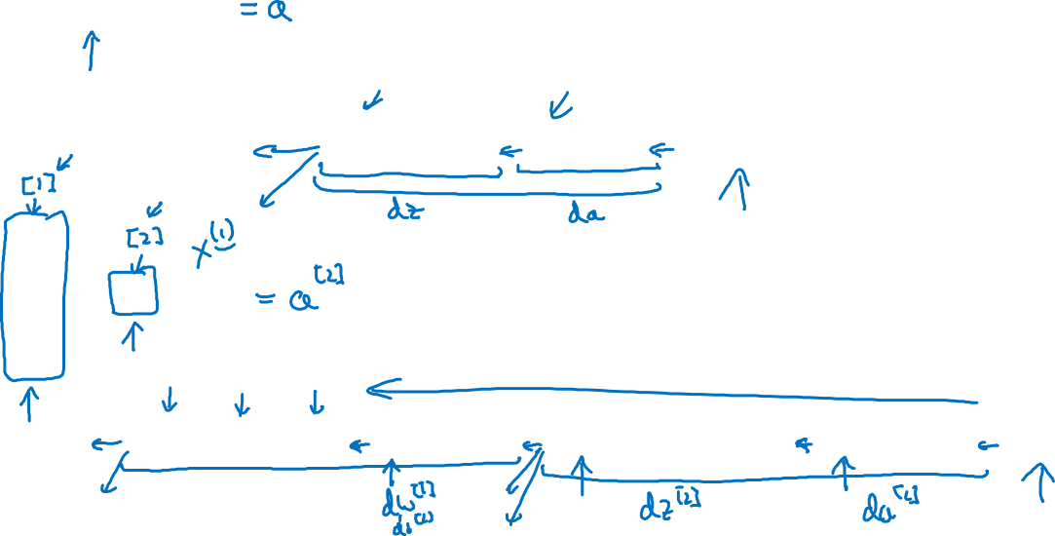





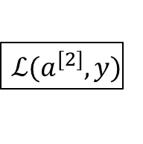







What is a Neural Network?
$$x_{1}$$
$$x_{2}$$
$$\hat{y}$$
$$x_{3}$$
x
w
$$z=w^{T}x+b$$
$$a=σ(z)$$
$$ℒ(a,y)$$
b
$$x_{1}$$
$$x_{2}$$
$$\hat{y}$$
$$x_{3}$$
x
$$W^{[1]}$$
$$z^{[1]}=W^{[1]}x+b^{[1]}$$
$$a^{[1]}=σ(z^{[1]})$$
$$z^{[2]}=W^{[2]}a_{ }^{[1]}+b^{[2]}$$
$$a^{[2]}=σ(z^{[2]})$$
$$ℒ(a^{[2]},y)$$
$$b^{[1]}$$
$$W^{[2]}$$
$$b^{[2]}$$

Slide 3


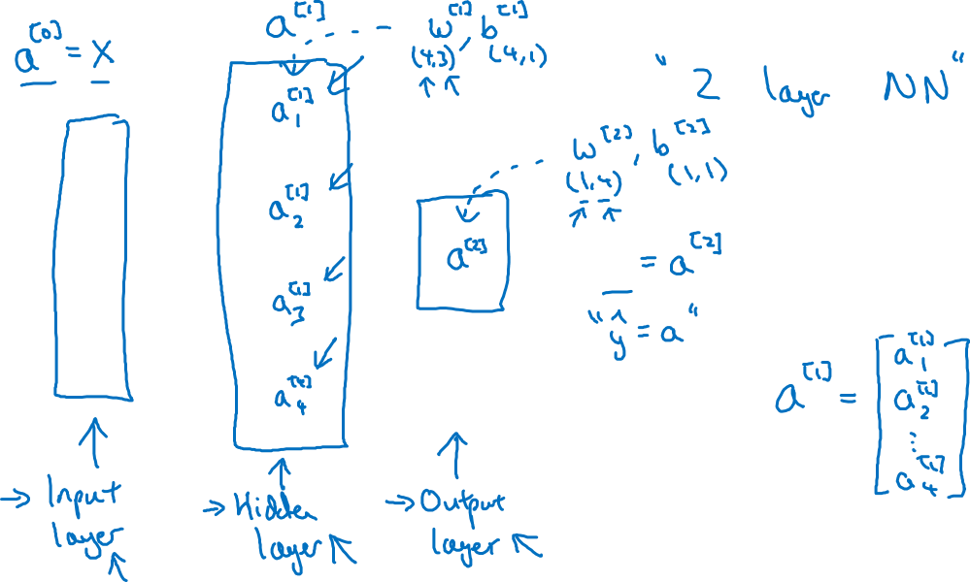


Neural Network Representation
$$x_{1}$$
$$x_{2}$$
$$\hat{y}$$
$$x_{3}$$

Slide 4

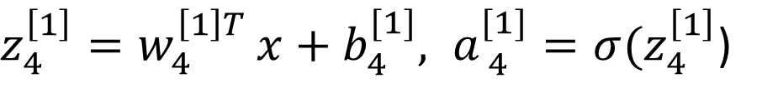


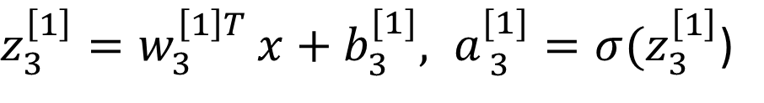


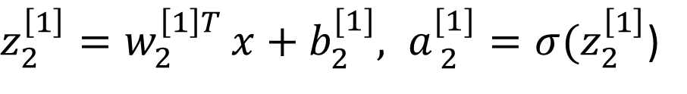

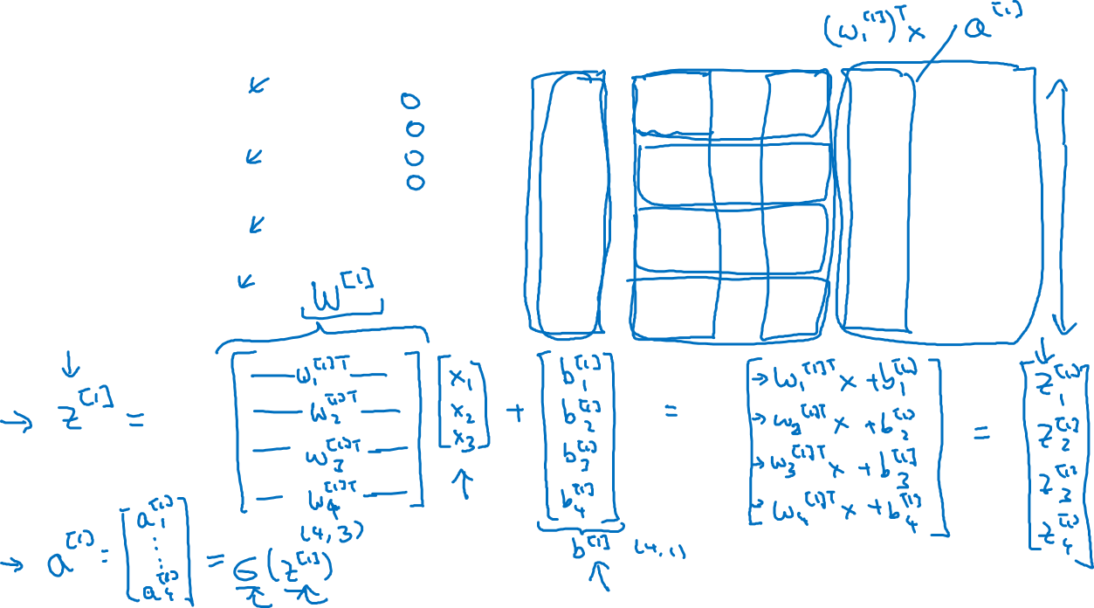
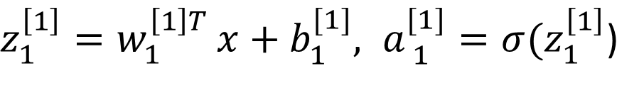


Neural Network Representation
$$a_{1}^{\left[1\right]}$$
$z_{1}^{\left[1\right]}=w_{1}^{{\left[1\right]T}^{ }}x+b_{1}^{[1]}, a_{ 1}^{[1]}=σ(z_{1}^{\left[1\right]}$)
$$x_{1}$$
$$a_{2}^{\left[1\right]}$$
$z_{2}^{\left[1\right]}=w_{2}^{{\left[1\right]T}^{ }}x+b_{2}^{[1]}, a_{ 2}^{[1]}=σ(z_{2}^{\left[1\right]}$)
$$x_{2}$$
$$\hat{y}$$
$$a_{3}^{\left[1\right]}$$
$z_{3}^{\left[1\right]}=w_{3}^{{\left[1\right]T}^{ }}x+b_{3}^{[1]}, a_{ 3}^{[1]}=σ(z_{3}^{\left[1\right]}$)
$$x_{3}$$
$$a_{4}^{\left[1\right]}$$
$z_{4}^{\left[1\right]}=w_{4}^{{\left[1\right]T}^{ }}x+b_{4}^{[1]}, a_{ 4}^{[1]}=σ(z_{4}^{\left[1\right]}$)

Slide 5
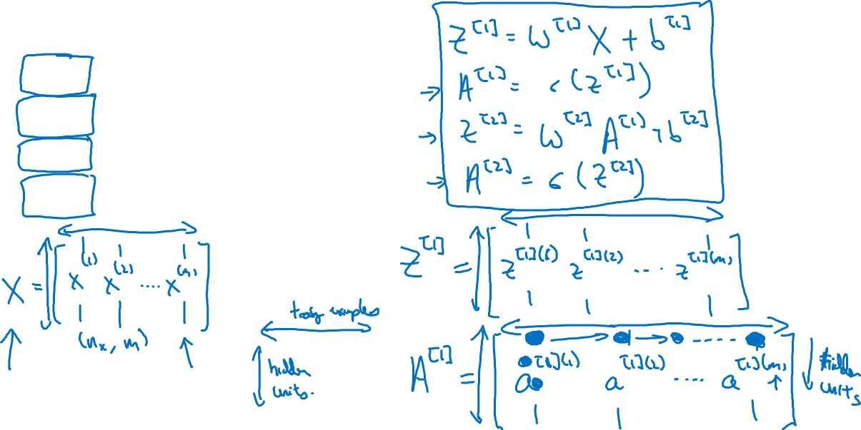




Vectorizing across multiple examples
for i = 1 to m:
$$z^{\left[1\right](i)}=W^{\left[1\right]}x^{(i)}+b^{\left[1\right]}$$
$$a^{\left[1\right](i)}=σ(z^{\left[1\right]\left(i\right)})$$
$$z^{\left[2\right](i)}=W^{\left[2\right]}a^{\left[1\right](i)}+b^{\left[2\right]}$$
$$a^{\left[2\right](i)}=σ(z^{\left[2\right]\left(i\right)})$$

Slide 6
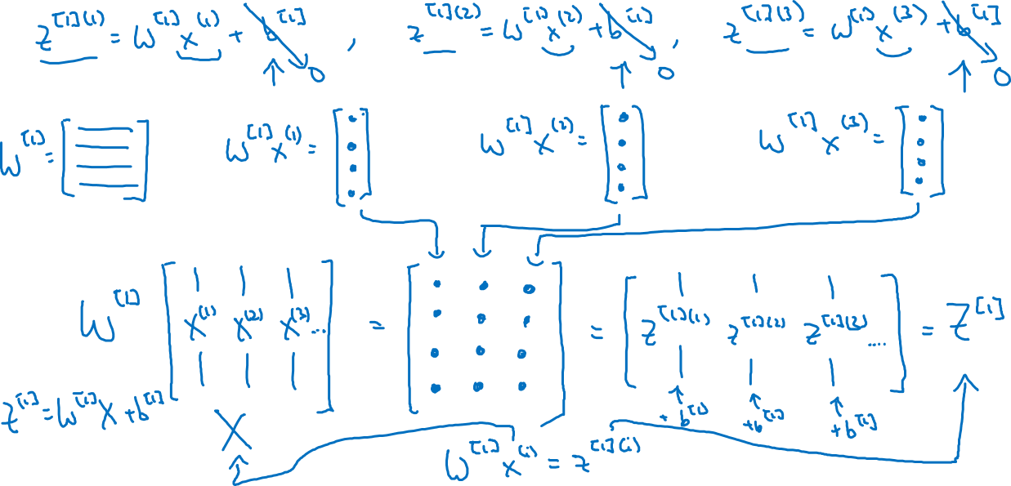
Justification for vectorized implementation

Slide 7











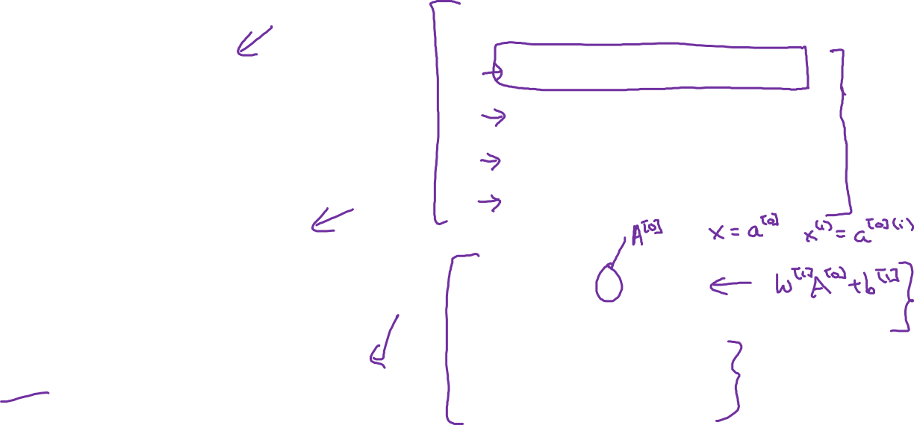





Recap of vectorizing across multiple examples
for i = 1 to m
$$x_{1}$$
$$z^{\left[1\right](i)}=W^{\left[1\right]}x^{(i)}+b^{\left[1\right]}$$
$$x_{2}$$
$$\hat{y}$$
$$x_{3}$$
$$a^{\left[1\right](i)}=σ(z^{\left[1\right]\left(i\right)})$$
$$z^{\left[2\right](i)}=W^{\left[2\right]}a^{\left[1\right](i)}+b^{\left[2\right]}$$
$$a^{\left[2\right](i)}=σ(z^{\left[2\right]\left(i\right)})$$
$$X=$$
$$x^{(1)}$$
$$x^{(2)}$$
…
$$x^{(m)}$$
$$Z^{\left[1\right]}=W^{\left[1\right]}X+b^{\left[1\right]}$$
$$A^{\left[1\right]}=σ(Z^{\left[1\right]})$$
$$Z^{\left[2\right]}=W^{\left[2\right]}A^{\left[1\right]}+b^{\left[2\right]}$$
$A^{[1]}=$
$$a^{[1](1)}$$
$$a^{[1](2)}$$
$$a^{[1](m)}$$
…
$$A^{\left[2\right]}=σ(Z^{\left[2\right]})$$

Slide 8




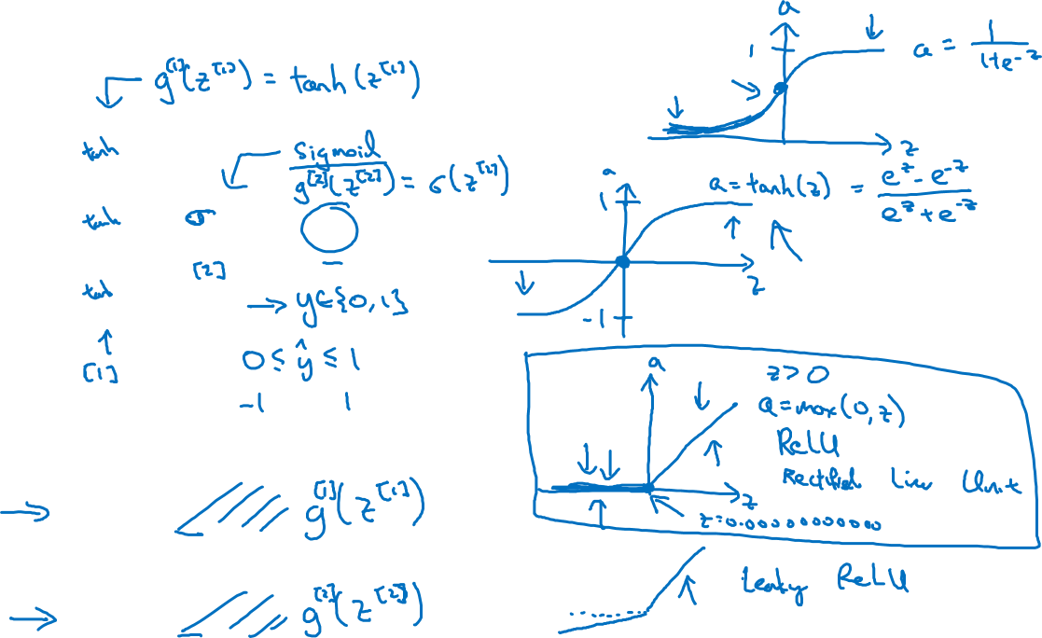


Activation functions
$$x_{1}$$
$$x_{2}$$
$$\hat{y}$$
$$x_{3}$$
Given x:
$$z^{\left[1\right]}=W^{\left[1\right]}x+b^{\left[1\right]}$$
$$a^{\left[1\right]}=σ(z^{\left[1\right]})$$
$$z^{\left[2\right]}=W^{\left[2\right]}a^{\left[1\right]}+b^{\left[2\right]}$$
$$a^{\left[2\right]}=σ(z^{\left[2\right]})$$

Slide 9

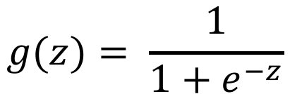
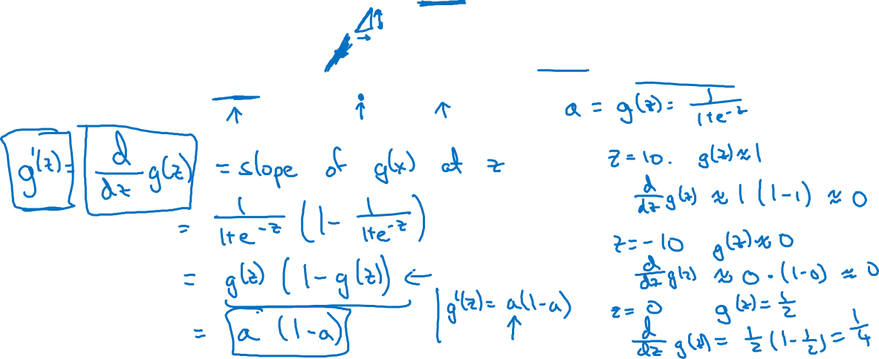
Sigmoid activation function
a
$$g(z)= \frac{1}{1+e^{−z}}$$
z

Slide 10

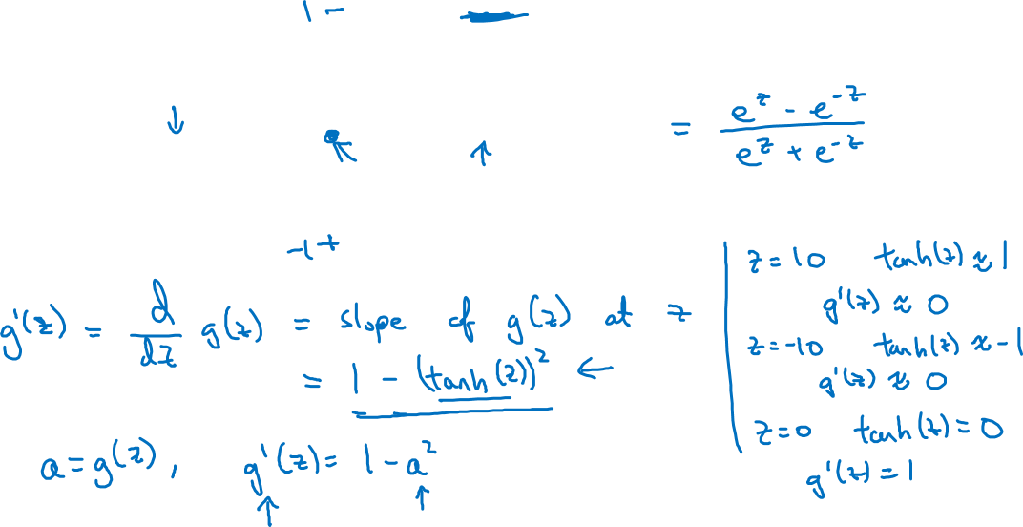
Tanh activation function
a
$$g(z)=tanh(z){ }$$
z

Slide 11
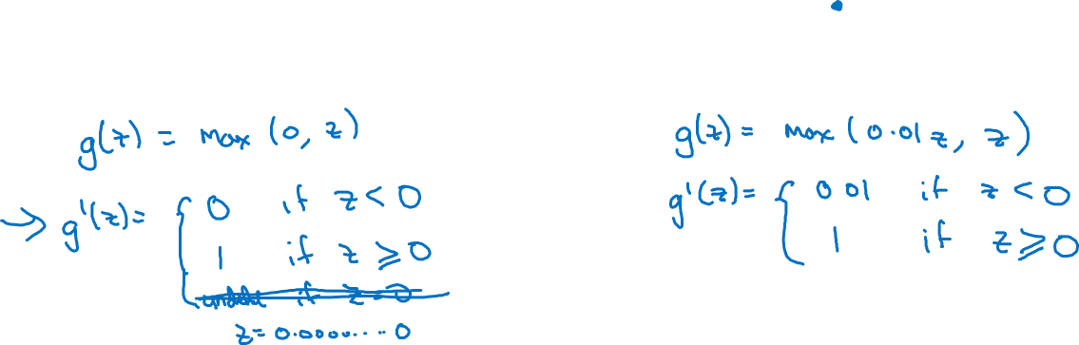
ReLU and Leaky ReLU
a
a
z
z
ReLU
Leaky ReLU

Slide 12






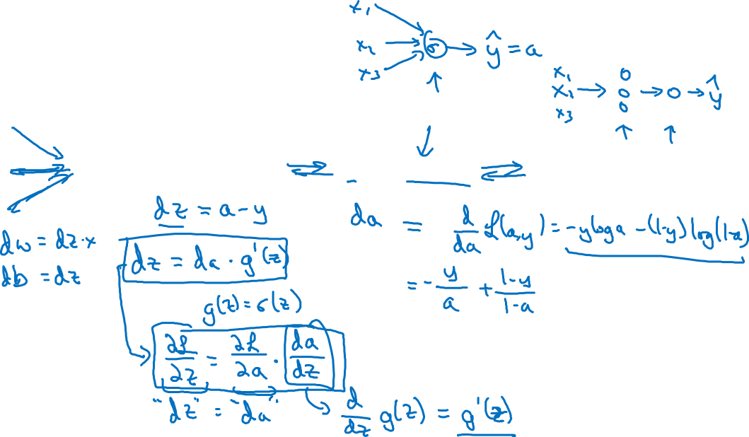
Computing gradients
Logistic regression
$$x$$
$$w$$
$$z=w^{T}x+b$$
$$a= σ(z)$$
$$ℒ(a,y)$$
$$b$$

Slide 13

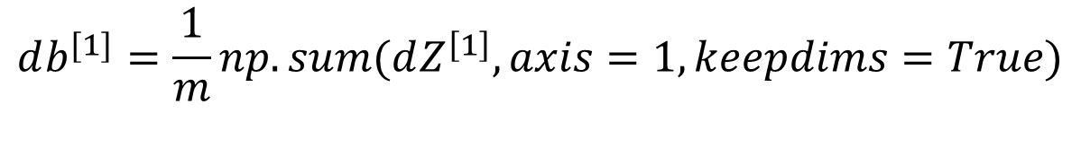


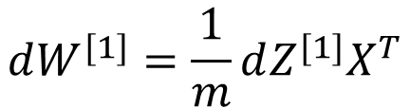


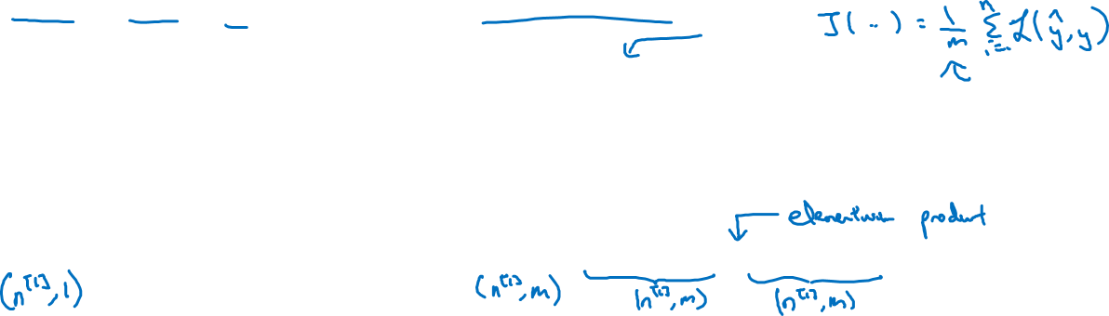

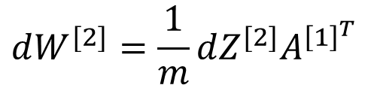
Summary of gradient descent
$$dz^{[2]}=a^{[2]}−y$$
$$dZ^{[2]}=A^{[2]}−Y$$
$$dW^{[2]}=dz^{[2]}a^{{\left[1\right]}^{T}}$$
$$dW^{[2]}=\frac{1}{m}dZ^{[2]}A^{{\left[1\right]}^{T}}$$
$$db^{[2]}=dz^{[2]}$$
$$db^{[2]}=\frac{1}{m}np.sum(dZ^{\left[2\right]},axis=1, keepdims=True)$$
$$dz^{[1]}=W^{\left[2\right]T}dz^{[2]}∗g^{[1]}′(z^{\left[1\right]})$$
$$dZ^{[1]}=W^{\left[2\right]T}dZ^{[2]}∗g^{[1]}′(Z^{\left[1\right]})$$
$$dW^{[1]}=dz^{[1]}x^{T}$$
$$dW^{[1]}=\frac{1}{m}dZ^{[1]}X^{T}$$
$$db^{[1]}=dz^{[1]}$$
$$db^{[1]}=\frac{1}{m}np.sum(dZ^{\left[1\right]},axis=1, keepdims=True)$$

Slide 14






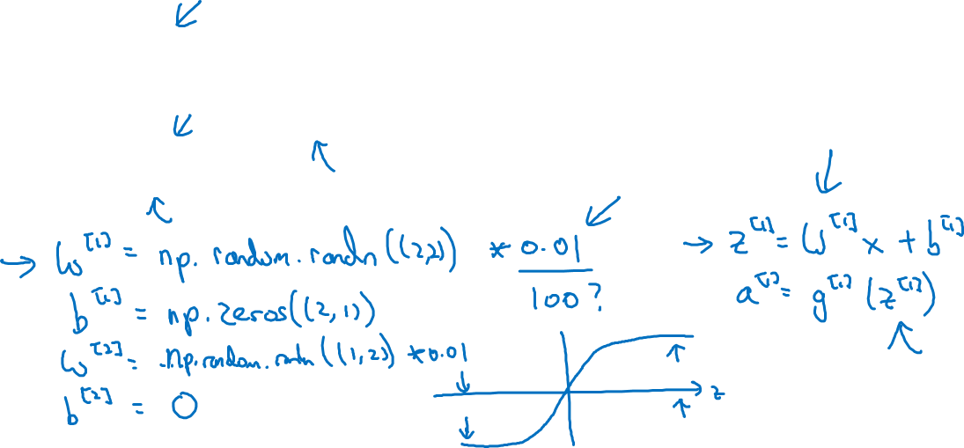
Random initialization
$$x_{1}$$
$$a_{1}^{[1]}$$
$$a_{1}^{[2]}$$
$$\hat{y}$$
$$x_{2}$$
$$a_{2}^{[1]}$$

